Slide 1

Chapter 9
Using Telephone
and Cable Networks
for Data Transmission

Slide 2
9.1 TELEPHONE NETWORK
Telephone networks use circuit switching. The telephone network had its beginnings in the late 1800s. The entire network, which is referred to as the plain old telephone system (POTS), was originally an analog system using analog signals to transmit voice.
Topics discussed in this section:
Major Components
LATAs
Signaling
Services Provided by Telephone Networks

Slide 3
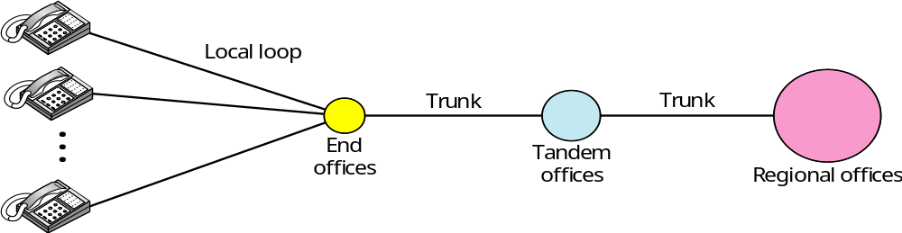
Telephone Networks : Major Components
Figure 9.1 A telephone system
local loop connects subscriber to nearest end office, 1st 3 digits of phone number define the office, next four define the local loop number
trunks are the transmission media handling the communication between offices
switching office has switches that connects several local loops or trunks

Slide 4
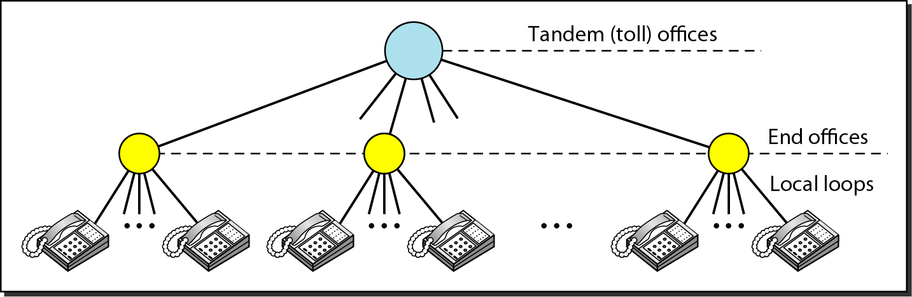
Telephone Networks
Figure 9.2 Switching offices in a LATA
LATA (Local –access Transport area)

Slide 5
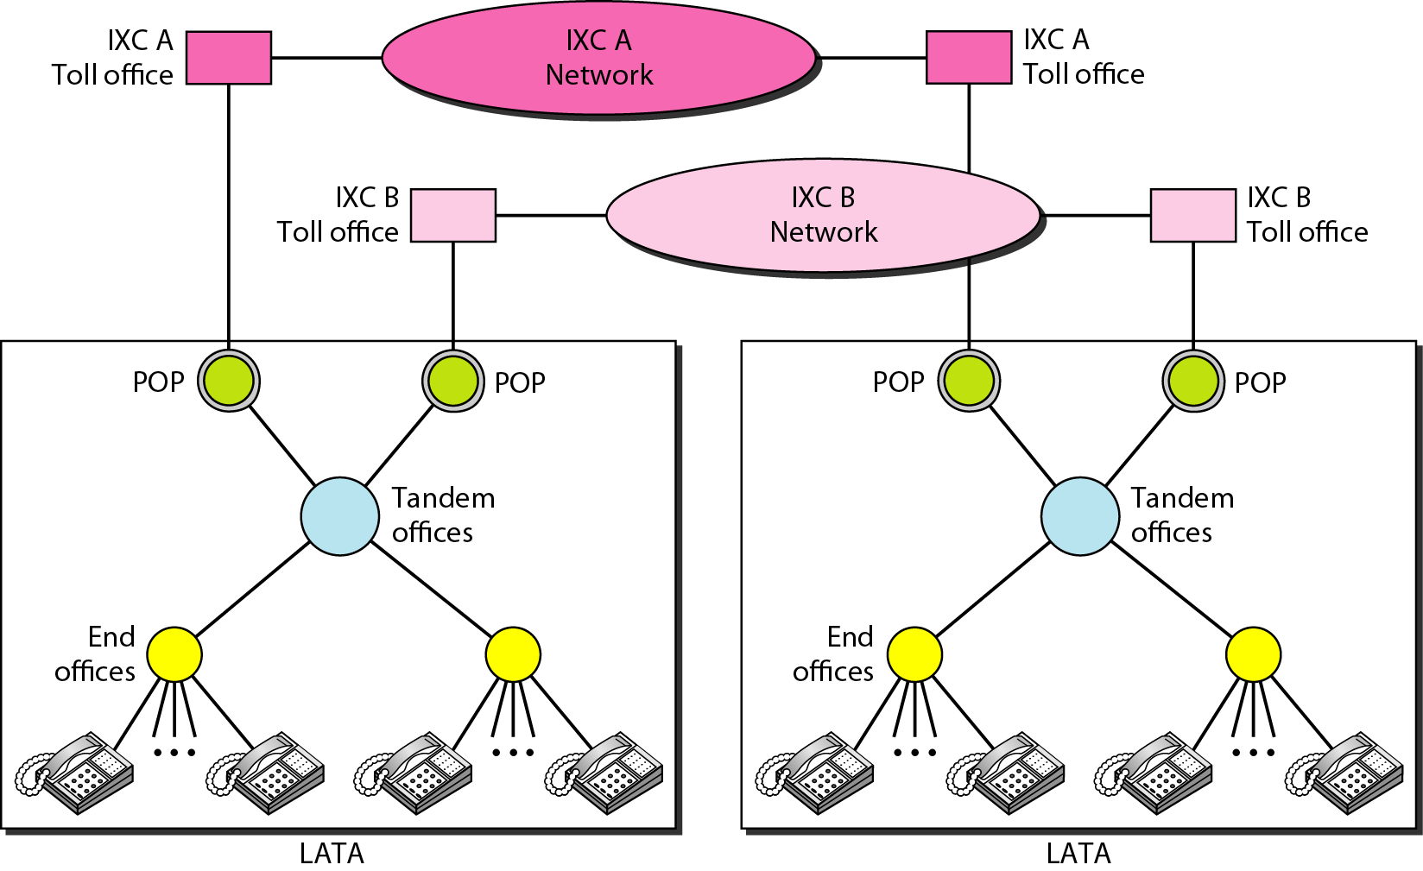
Telephone Networks
Figure 9.3 Point of presences (POPs)

Slide 6
Signaling
The switches in the telephone company used the digital signals (telephone number) to create a connection between the caller and the called parties.
  In-band signaling
    The 4khz voice channel is used to provide signaling.
    The same circuit can be used for both signaling and voice communication.
  Out-band signaling
    A portion of the 4khz voice channel bandwidth is used for signaling.
    The voice bandwidth and the signaling bandwidth are separated.

Slide 7

Signaling
Note
The tasks of data transfer and signaling are separated in modern telephone networks: data transfer is done by one network, signaling by another.

Slide 8
Signaling Network
The signaling network is a packet-switched network involving the layers in the OSI model or Internet model.
For example, the information needed to convey a telephone address can easily be encapsulated in a packet with all the error control and addressing information.
The signaling network is consisted of the SP, STP, SCP, and Data base.

Slide 9
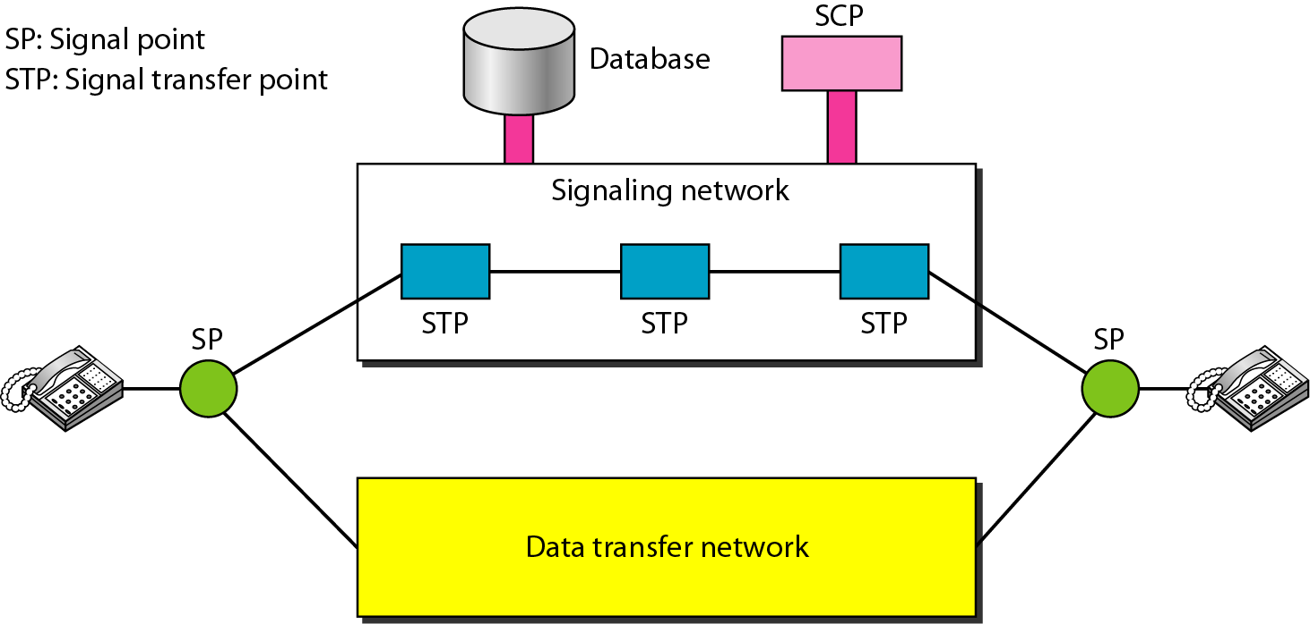
Signaling Network
Figure 9.4 Data transfer and signaling networks

Slide 10
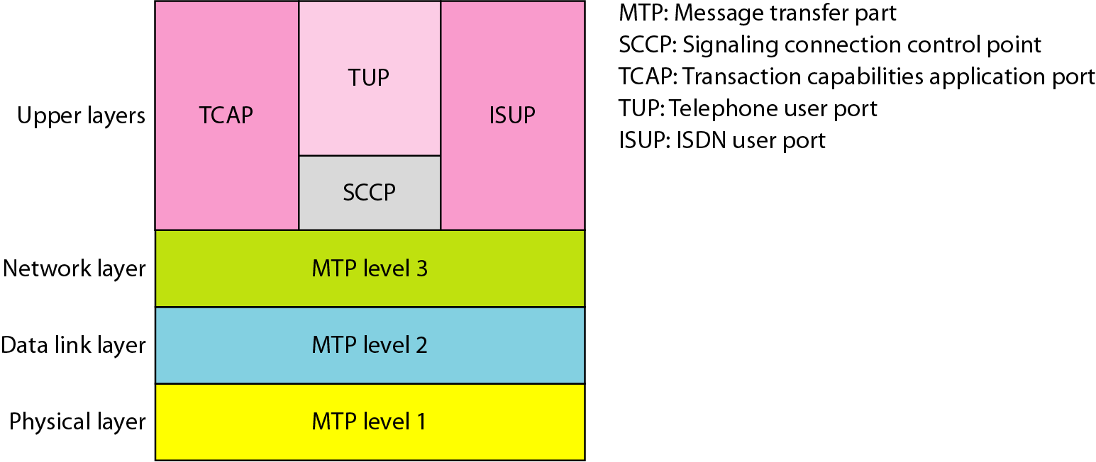
Signaling system seven (SS7)
The protocol that is used in the signaling network is called Signaling System Seven (SS7)
Figure 9.5 Layers in SS7

Slide 11
9.2 DIAL-UP MODEMS
Traditional telephone lines can carry frequencies between 300 and 3300 Hz, giving them a bandwidth of 3000 Hz. All this range is used for transmitting voice, where a great deal of interference and distortion can be accepted without loss of intelligibility.
Topics discussed in this section:
Modem Standards

Slide 12
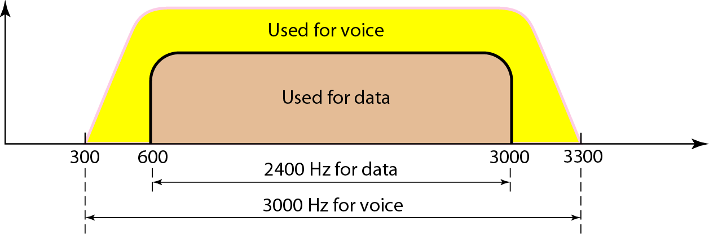
Dial-up modem
Traditional, telephone lines can carry frequencies between 300 and 3300Hz, giving them a bandwidth of 3000 Hz.
The effective bandwidth of a telephone line being used for data communication is 2400 Hz, covering the range from 600 and 3000 Hz.
Figure 9.6 Telephone line bandwidth

Slide 13
Dial-up modem
Note
Modem
stands for modulator/demodulator.

Slide 14
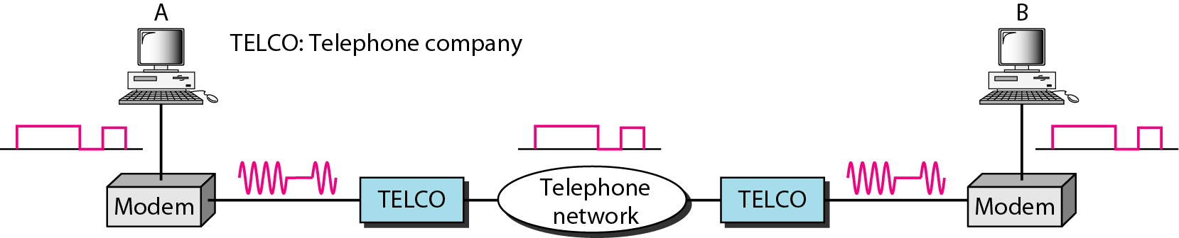
Modem
The computer sends a digital signal to the modulator portion of the modem; the data sent as an analog signal on the telephone lines.
The modem on the right receives the analog signal, demodulates it through its demodulator, and delivers data to the computer on the right.
Figure 9.7 Modulation/demodulation

Slide 15
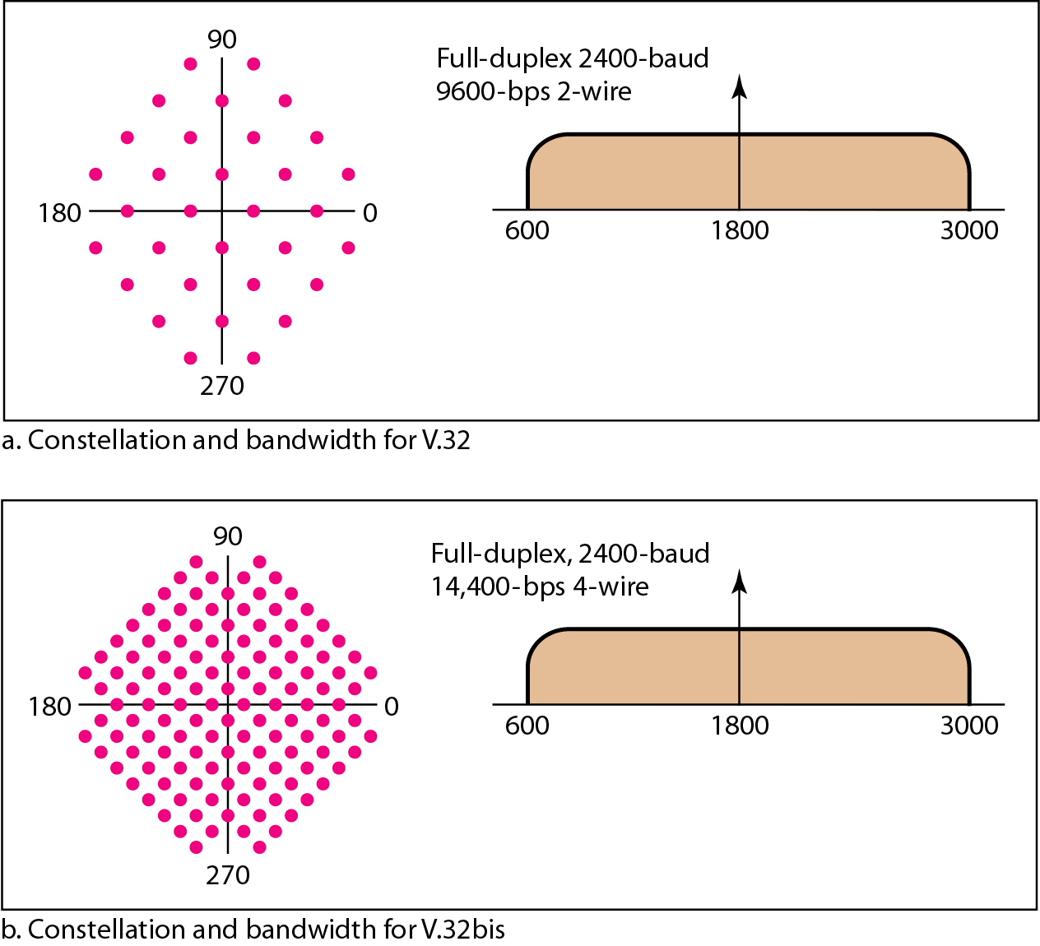
Modem standards
ITU V Series
32-QAM (V.32) with a baud rate of 2400
4 data bits x 2400 = 9600 bps
128-QAM (V.32bis)
6 data bits x 2400 baud
= 14,400 bps
Automatic fall-back, fall- forward feature enabling modem to adjust speed depending on line or signal quality

Slide 16
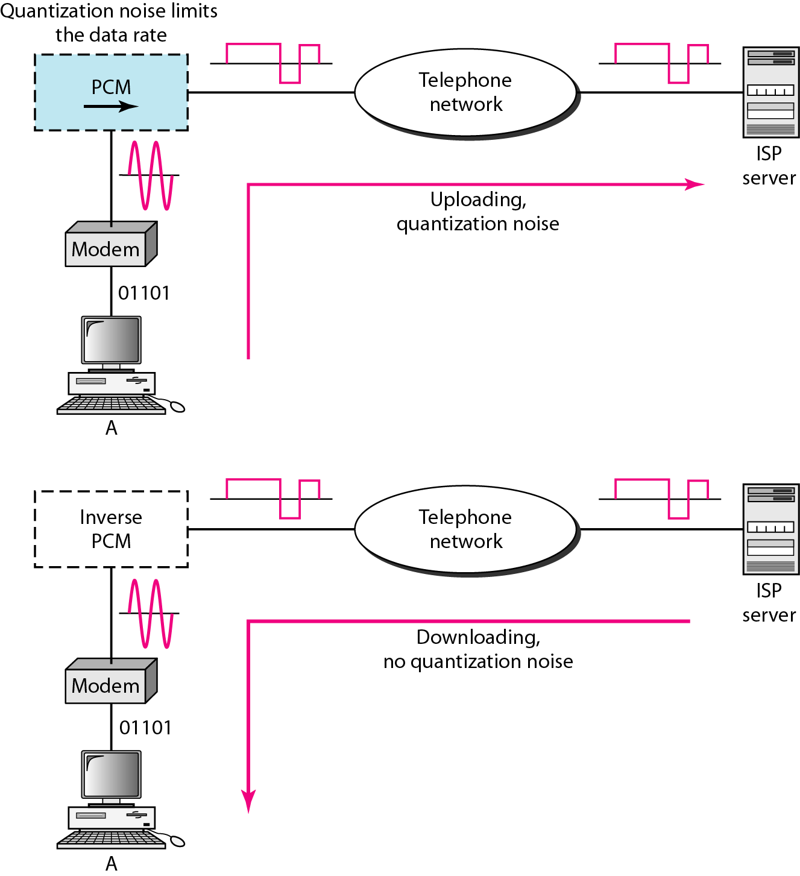
Modem standards
Figure 9.9 Uploading and downloading in 56K modems
33.6kbps
56kbps

Slide 17
9.3 DIGITAL SUBSCRIBER LINE
After traditional modems reached their peak data rate, telephone companies developed another technology, DSL, to provide higher-speed access to the Internet. Digital subscriber line (DSL) technology is one of the most promising for supporting high-speed digital communication over the existing local loops.
Topics discussed in this section:
ADSL
ADSL Lite
HDSL
SDSL
VDSL

Slide 18
Digital Subscriber Line (DSL)
uses a newer technology that used the existing telecommunications networks such as the local loop telephone line.
is an asymmetric communication technology designed for residential users; it is not suitable for business.
xDSL: where x can be replaced by A, V, H, or S
The existing local loops can handle bandwidths up to 1.1 MHz
  by removing the filter at the end of line of telephone company
  but, limitation because of distance between the residence and the switching office, size of cable
ADSL is an adaptive technology. The system uses a date rate based on the condition of the local loop line

Slide 19
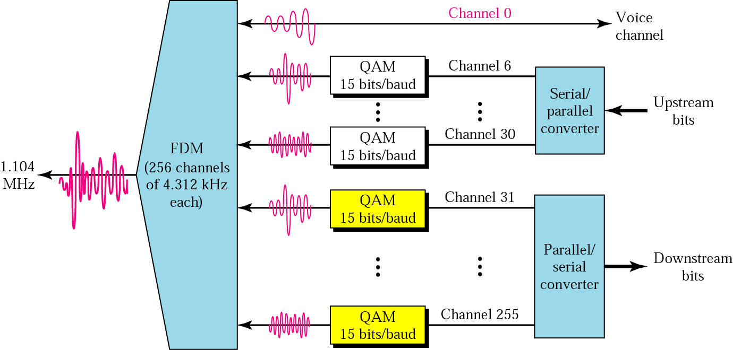
DSL
DMT
  Modulation technique that has become standard for ADSL is called the discrete multitone technique (DMT) which combines QAM and FDM.

Slide 20
DSL
voice : channel 0 is reserved for voice
Idle : channel 1 to 5 are not used; gap between voice and data communication
Upstream data and control : channels 6 to 30 (25channels); one channel for control
Downstream data and control : channels 31 to 255(225 channels); 13.4 Mbps; one channel for control

Slide 21
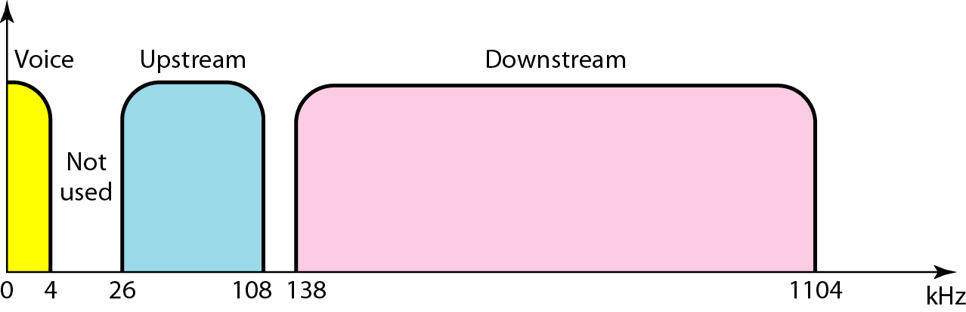
DSL
Figure 9.11 Bandwidth division in ADSL

Slide 22
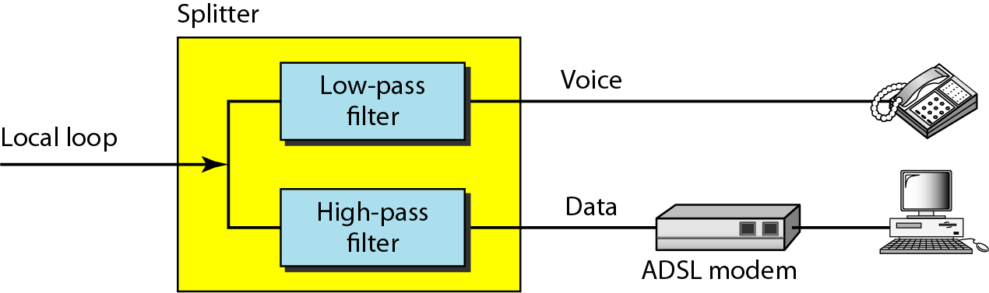
DSL
Figure 9.12 ADSL modem – customer site

Slide 23
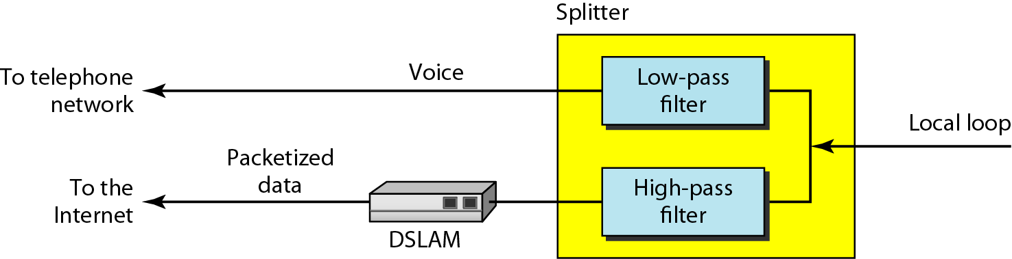
DSL
Figure 9.13 DSLAM – Telephone company site
DSLAM (Digital Subscriber Line Access Multiplexer)

Slide 24
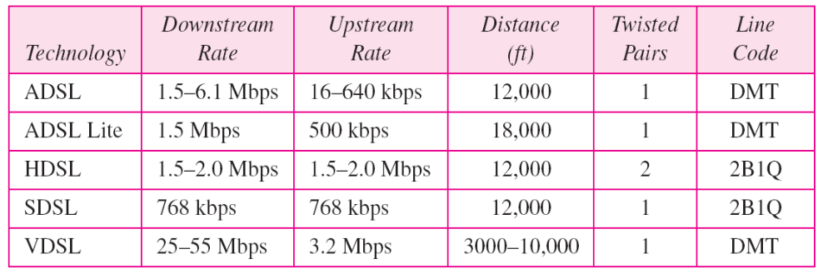
DSL
Table 9.2 Summary of DSL technologies

Slide 25
9.4 CABLE TV NETWORKS
The cable TV network started as a video service provider, but it has moved to the business of Internet access. In this section, we discuss cable TV networks per se; in Section 9.5 we discuss how this network can be used to provide high-speed access to the Internet.
Topics discussed in this section:
Traditional Cable Networks
Hybrid Fiber-Coaxial (HFC) Network

Slide 26
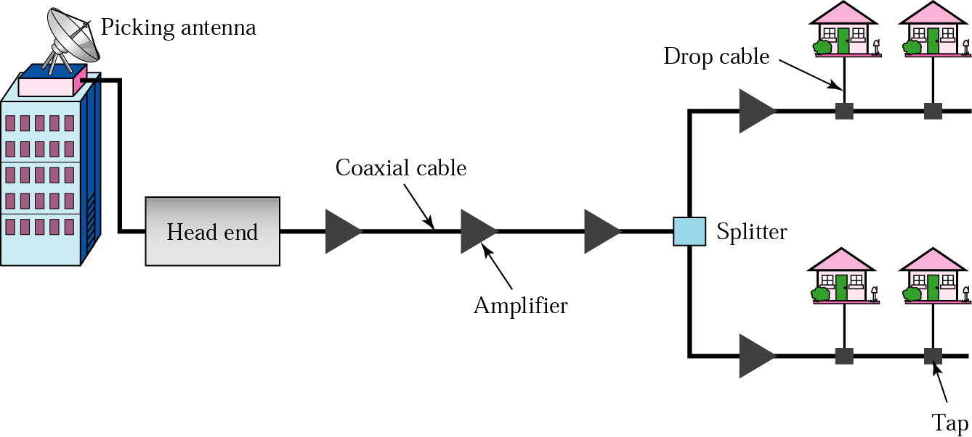
Cable Modem
Traditional cable Networks
  community antenna TV (CATV)
Communication in the traditional cable TV network is unidirectional.

Slide 27
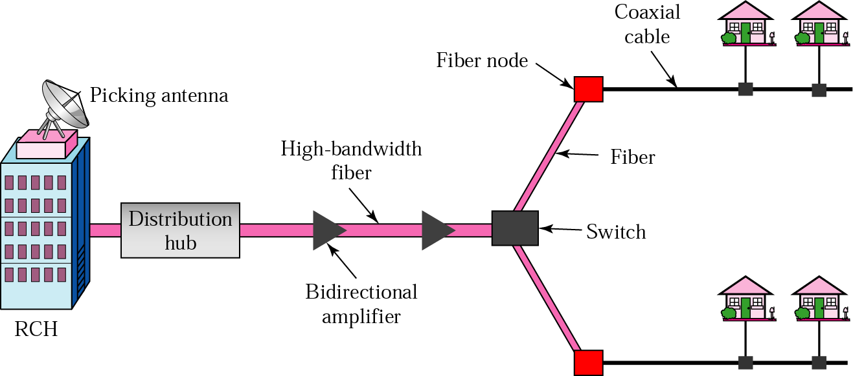
Cable Modem
HFC Network
  RCH : Regional cable head; serving 400,000 subscribers;
  Distribution hub: serving 40,000 subscribers
  Coaxial cable : serving 1,000 subscribers
  Communication in HFC cable TV network can be bidirectional.

Slide 28
Cable Modem
Note
Communication in an HFC cable TV network can be bidirectional.

Slide 29
9.5 CABLE TV FOR DATA TRANSFER
Cable companies are now competing with telephone companies for the residential customer who wants high-speed data transfer. In this section, we briefly discuss this technology.
Topics discussed in this section:
Bandwidth
Sharing
CM and CMTS
Data Transmission Schemes: DOCSIS

Slide 30
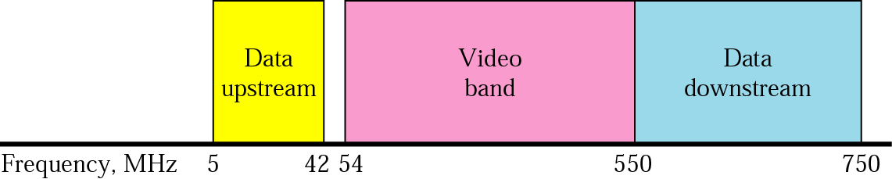
Cable Modem
Bandwidth
Video band
  54 to 550 MHz
  TV channels : 6 Mhz x 80 channels

Slide 31
Cable Modem
Data downstream band : dividing into 6Mhz channels
  Modulation
    Downstream data are modulated using 64-QAM
  Data rate
    6 bits for each baud in 64-QAM (1bit : control bit)
    Theoretically, 5bits/Hz x 6 Mhz = 30 Mbps
Upstream data band
  Modulation
    upstream data band uses lower frequencies that are more susceptible to noise and interference
    for this reason, using QPSK instead of QAM
  Theoretical data rate : 2 bits/hz x 6 Mhz = 12 Mbps

Slide 32
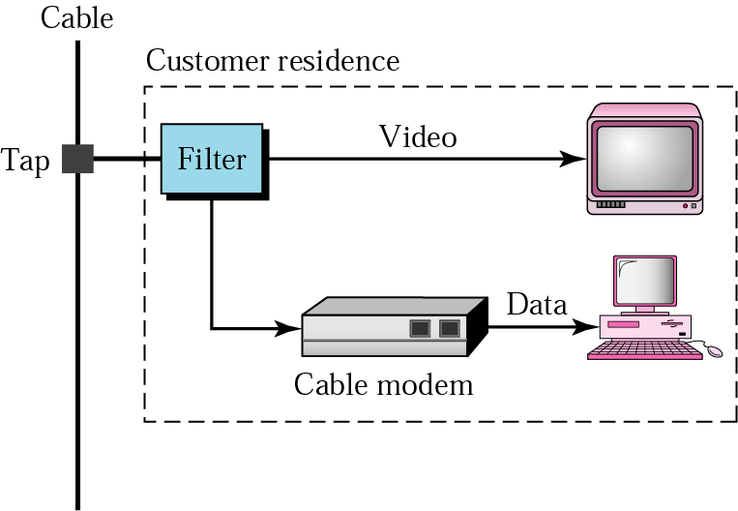
Cable Modem
The Cable Modem (CM) is installed on the subscriber premises.
Figure 9.17 Cable modem (CM)

Slide 33
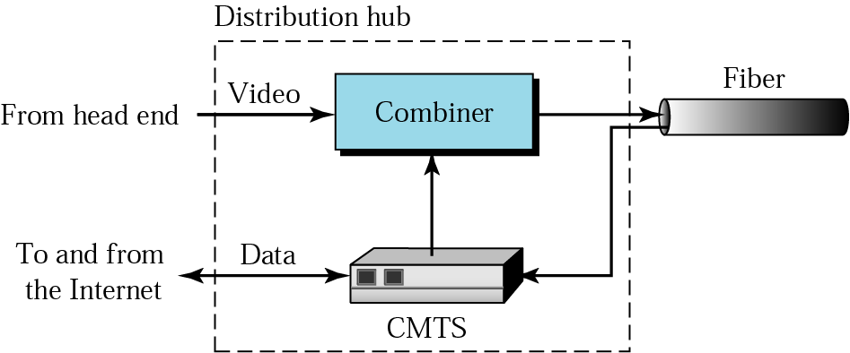
Cable Modem
Cable modem transmission system (CMTS)
  The CMTS is installed inside the distribution hub by the cable company.
  Mbps
Figure 9.18 Cable modem transmission system (CMTS)

Slide 34
Data transmission Schemes (DOCIS)
DOCIS (Data Over Cable System Interface Specification) defines all the protocols necessary to transport data from a CMTS to a CM.
  Upstream Communication
    It describes the steps that must be followed by a CM.
  Downstream Communication
    There is no contention because there is only one sender.
    The CMTS sends the packet with the address of the receiving CM, using the allocated downstream channel.

Slide 35
Summary (1)
The telephone, which is referred to as the plain old telephone system (POTS), was originally an analog system. During the last decade, the telephone network has undergone many technical changes. The network is now digital as well as analog.
The telephone network is made of three major components: local loops, trunks, and switching offices. It has several levels of switching offers such as end offices, tandem offices, and regional offices.

Slide 36
Summary (2)
Telephone companies developed another technology, digital subscriber line (DSL), to provide higher-speed access to the Internet
Community antenna TV (CATV) was originally designed to provide video services for the community. The traditional cable TV system used coaxial cable end to end. The second generation of cable networks is called a hybrid fiber-coaxial (HFC) network. The network uses a combination of fiber-optic and coaxial cable.

Slide 37

Q & A

